Slide 1

Technology: Python
Performance Analysis of Intrusion Detection Systems Using a Feature Selection Method

Slide 2
INDEX
Abstract
Introduction
Literature review
Existing Method
Drawbacks
Proposed method
Advantages
Implementation
Modules
Hardware and Software Requirements
Algorithms
UML Diagrams
Results
Conclusion
References

Slide 3
ABSTRACT
Computer networks intrusion detection systems (IDSs) and intrusion prevention systems (IPSs) are critical aspects that contribute to the success of an organization. Over the past years, IDSs and IPSs using different approaches have been developed and implemented to ensure that computer networks within enterprises are secure, reliable and available. In this paper, we focus on IDSs that are built using machine learning (ML) techniques. IDSs based on ML methods are effective and accurate in detecting networks attacks. However, the performance of these systems decreases for high dimensional data spaces. Therefore, it is crucial to implement an appropriate feature extraction method that can prune some of the features that do not possess a great impact in the classifcation process. Moreover, many of the ML based IDSs suffer from an increase in false positive rate and a low detection accuracy when the models are trained on highly imbalanced datasets. In this paper, we present an analysis the UNSW-NB15 intrusion detection dataset that will be used for training and testing our models.

Slide 4
Moreover, we apply a flter-based feature reduction technique using the XGBoost algorithm. We then implement the following ML approaches using the reduced feature space: Support Vector Machine (SVM), k-Nearest-Neighbour (KNN), Logistic Regression (LR), Artifcial Neural Network (ANN) and Decision Tree (DT). In our experiments, we considered both the binary and multiclass classification configurations. The results demonstrated that the XGBoost-based feature selection method allows for methods such as the DT to increase its test accuracy for the binary classification scheme.
Keywords: Machine learning, Feature engineering, Computer networks, Intrusion detection.

Slide 5
INTRODUCTION
The rapid pace at which technologies such as the Internet, Internet-of-Tings (IoT) and communication systems is advancing has caused hackers to evolve with a higher velocity in terms of their capabilities. These criminals strive to discover new ways to compromise computer networks security. Therefore, Intrusion Detection Systems (IDSs) inherently become critical components in a computer network. An IDS is defend as a hardware or a software system that monitors an organization’s computer network for imminent and potential threats or attacks. Moreover, an IDS is capable of responding to any malicious transactions and report them accordingly. IDSs are categorized in 3 broad classes, namely, node or host based IDS (HIDS) network or distributed IDS (DIDS or NIDS) and Hybrid IDS (HYIDS) this classification is based on the specific IDS operation philosophy. HIDS runs on a single node computer system and it is concerned with the security related to its host. In contrast, a DIDS runs on a distributed computer network and analyses the traffic at the network level for suspicious activities.

Slide 6
A signature-based IDS uses an existing data store of previously intercepted attacks in order to detect intrusions. In contrast, an anomaly-based IDS is concerned with the behaviour of the network. It constantly checks for activities that constitute unusual behaviour and fags them. Finally, hybrid based IDS is a combination of both anomaly-based and signature-based IDSs. The primary philosophical design goal of an IDS is to minimise instances of false positive alarms and to increase its detection accuracy. Therefore, the design and implementation of any IDS must take that philosophy in consideration. In recent years, Machine Learning (ML) based IDSs have emerged as the leading systems in the intrusion detection research domain. ML gives systems the ability of learning and improving by using previous data. In other words, ML based computer programs do not need to be explicitly engineered (programmed). They are capable of learning by themselves [8]. Broadly speaking, there exist the following sorts of ML philosophies, namely, supervised ML and unsupervised ML. In the case of supervised ML, models are learned using data that is labelled. In the instance of unsupervised ML, the data that is used to train models is unstructured (unlabelled).

Slide 7
LITERATURE REVIEW
S. No | Journal Type with year | Authors | Title | Outcomes
1 | IEEE, 2020 | Ribeiro J, Saghezchi FB, Mantas G, Rodriguez J, Abd-Alhameed RA | Hidroid: prototyping a behavioral host-based intrusion detection and prevention system for android | In this paper, we develop a novel Host-based IDPS for Android (HIDROID), which runs completely on a mobile device, with a minimal computation burden
2 | IEEE, 2015 | Van NTT, Thinh TN | Accelerating anomaly-based IDS using neural network on GPU | In this paper, we used Neural Network technology to classify normal or abnormal behaviours.
3 | Journal, 2015 | Jabez J, Muthukumar B | Intrusion detection system (IDS): anomaly detection using outlier detection approach | This research work proposed a new approach called outlier detection where, the anomaly dataset is measured by the Neighbourhood Outlier Factor (NOF)
4 | ICDCN, 2009 | Neelakantan S, Rao S. | A threat-aware anomaly-based intrusion-detection approach for obtaining network-specifc useful alarms | In this paper, we present a Threat-Aware Anomaly-Based IDS model for obtaining network-specific useful alarms

Slide 8
EXISTING METHOD
The increasing growth of machine learning, computer techniques divided into traditional methods and machine learning methods. This section describes the related works of performance of Intrusion Detection systems and how machine learning methods are better than traditional methods. The existing method in this project have a certain flow is used for model development. SVM and ANN are used algorithms in existing system. But it requires large memory and result is not accurate.
DISADVANTAGES
Accuracy low
Requires more time
Difficult to handle

Slide 9
PROPOSED METHOD
Much research has been done on studying performance analysis of intrusion detection of systems. In early days if have to check the system performance it’s a time taking process. We can detect the system performance by using Decision tree, KNN (K-Nearest Neighbour), LG (Logistic Regression), Decision Tree, XGBoost. To get better accuracy we used Decision Tree algorithm. Bu using these machine learning techniques we can easily detect the system performance like weather the system is attacked or not.
Advantages:
Requires less time
Good Accuracy
Easy to handle

Slide 10
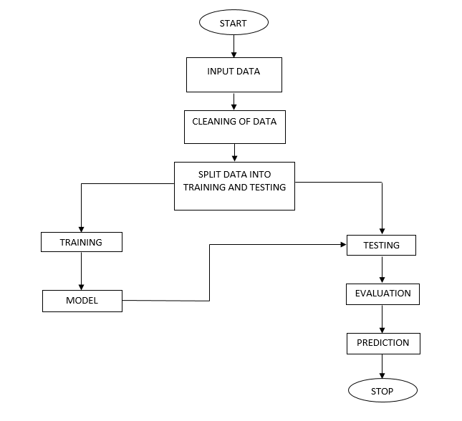
BLOCK DIAGRAM

Slide 11
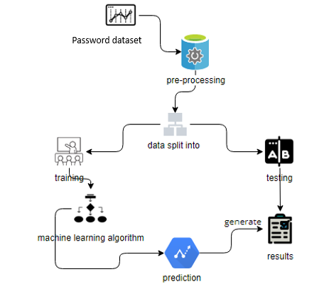
ARCHITECTURE

Slide 12
IMPLEMENTATION
First we have taken the UNSW_NB15 of CSV file.
Load the dataset into work environment and made a check for null values if any.
After checking the null values split the data in to train data and test data.
After splitting apply the algorithm and fit the train data and test data.
We got the best accuracy score of Decision Tree.
Later, the entire work is done with flask framework
User can view the Home, About, Login, Registration, User home page, Upload page, View page, Preprocessing, Model training, Prediction and Graph.
After detection, we will get to know that whether the Performance Analysis of Intrusion Detection Systems is Attacked are Not.

Slide 13
HARDWARE & SOFTWARE REQUIREMENTS
H/W Configuration:
• Processor - I3/Intel Processor
• Hard Disk -160GB
• RAM - 8Gb
S/W Configuration:
• Operating System : Windows 7/8/10 .
• IDE : Pycharm.
• Libraries Used : Numpy, Pandas, OS, Pillow, MySQL.
• Technology : Python 3.6+.

Slide 14
MODULES
1. System:
1.1 Store Dataset:
The System stores the dataset given by the user.
1.2 Model Training:
The system takes the data from the user and fed that data to the selected model.
1.3 Model Predictions:
The system takes the data given by the user and predict the output based on the given data.
1.4 Data Splitting:
Here the system can split the data into two parts for training and testing.

Slide 15
2. User:
2.1 Register:
Users can register for the Performance Analysis of Intrusion Detection Systems Using a Feature Selection Method application here.
2.2 Login:
After registering, the user can access his portal.
2.3 Load Dataset:
The user can upload the dataset he/she want to work on.
2.4 View Dataset:
The User can view the dataset.

Slide 16
2.5 Select model:
User can apply the model to the dataset for accuracy.
2.6 View results:
User can view the predicted results weather the system is attacked or not.

